Slide 1

MACHINE LEARNING · BIOINFORMATICS
Brain Cancer Classification
from Gene Expression Data
Classifying tumor types using PCA-reduced gene expression and a Random Forest classifier
Dedicated to my grandmother, whose battle with brain cancer inspired this project.
Dataset: GSE50161 (CuMiDa) · 130 patients · 54,675 genes · 5 tumor classes

Slide 2

Why This Project
A PERSONAL REASON
WHAT THE RESEARCH ACTUALLY SHOWS
Brain tumors are different from cancers like breast or colon cancer, where “caught early vs. caught late” survival gaps are huge and well documented. For brain tumors, evidence is more nuanced — but still points the same direction:
My grandmother passed away after a battle with brain cancer. Before she died, the tumor took her eyesight — one of the cruelest ways the disease can progress, as growing tumors can press on the optic nerve or visual pathways in the brain.
~40% of brain cancers in the UK are diagnosed only after an emergency hospital visit — the tumor was missed for far too long (NHS England data).
I never got a clear answer about exactly which type of brain tumor she had. That uncertainty is part of why this project matters to me — faster, clearer diagnosis shouldn't be out of reach.
A 2025 brain tumor diagnosis study linked shorter time-to-treatment with better outcomes, including survival.
A 2023 study found brain germ-cell tumor patients with delayed diagnosis (>6 months) had far worse 10-year survival (63%) than those diagnosed early (100%).
This project is my attempt to understand, in a small way, how data science could support earlier and more confident diagnosis for families like mine.
For glioblastoma specifically, earlier surgery after relapse was linked to longer survival in a 2024 meta-analysis of 2,200+ patients.
This is exactly why faster, data-driven classification tools matter — they can help close that diagnostic delay.

Slide 3
Project Roadmap
01
The Problem
02
The Dataset
Why classify brain tumors from genes?
130 patients, 54,675 genes, 5 tumor types
03
Why PCA?
04
XGBoost
Solving the curse of dimensionality
recall
05
Results and Model Comparison
06
What's Next
88.46% accuracy, full evaluation
Flask deployment & real-world use

Slide 4

The Problem
Diagnosing the exact type of brain tumor is critical — treatment plans differ completely between glioblastoma, medulloblastoma, ependymoma, and pilocytic astrocytoma. Misclassification can mean the wrong treatment.
5
Tumor classes
In the past, doctors had to perform surgery to remove a small piece of the tumor and then wait for lab tests to identify its type. Now, by analyzing gene activity from tumor tissue, we can classify brain tumors faster and more accurately using data.
130
Patient samples
54,675
Genes measured

Slide 5
Dataset Overview
Brain Cancer Gene Expression — CuMiDa (GSE50161 microarray)
46
Ependymoma
Tumor in the lining of brain/spinal cord
34
Glioblastoma
Most aggressive type — can cause vision loss
22
Medulloblastoma
Common in children, back of brain
15
Pilocytic Astrocytoma
Slow-growing brain tumor
13
Normal
Healthy brain tissue — control group

Slide 6

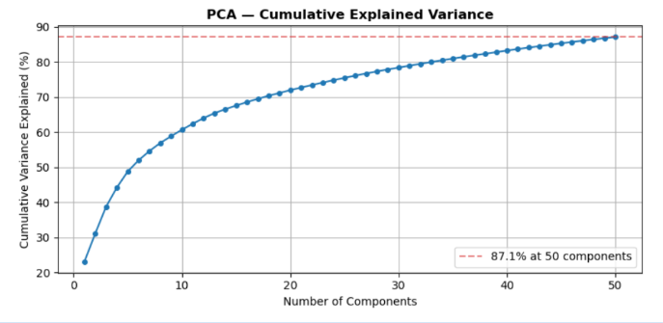
The Curse of Dimensionality
...and how PCA solves it
BEFORE PCA
AFTER PCA
54,675
50
gene features per patient — far more features than samples (26). Models overfit and struggle to find real patterns.
principal components, capturing 87.1% of the original variance. Same information, far less noise.
PCA finds the directions in the data with the most variation and compresses thousands of genes into a handful of “super-features” — without losing the patterns that matter.

Slide 7
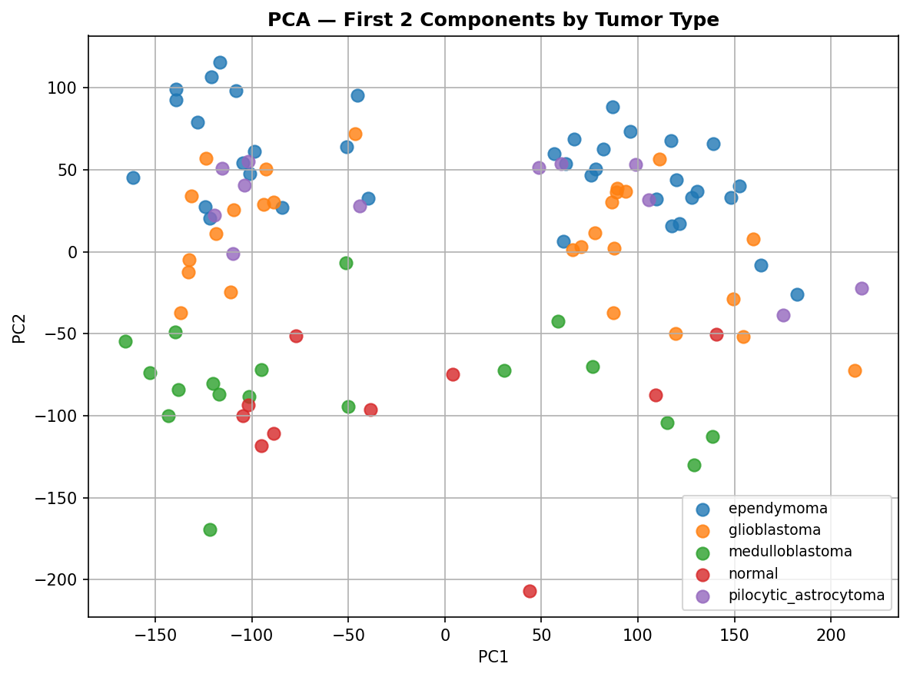
Do Tumor Types Separate in Gene-Expression Space?
First 2 principal components, colored by tumor type

Slide 8
How Random Forest Decides
1
Iterative Learning sequential decision trees are built one after the other. Instead of working independently, each new tree is grown specifically to correct the classification mistakes made by its predecessor.
2
Gradient Optimization the algorithm calculates the residual errors (like the missed Medulloblastoma cases) from the previous step. It minimizes these errors using gradient descent optimization, making it incredibly precise
3
Weighted Combination unlike a simple majority vote, the final prediction is a mathematically weighted sum of all trees. Trees that are highly confident and highly accurate carry more weight in the final diagnostic decision.
class_weight = ‘balanced’ — compensates for unequal class sizes (46 ependymoma vs only 13 normal samples) so rare tumor types aren’t ignored.

Slide 9
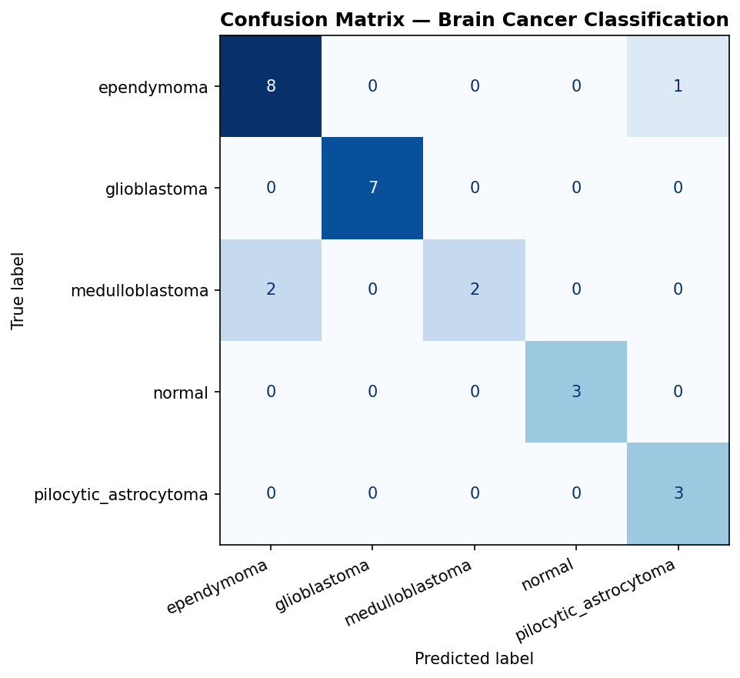
Results
Tumor Type | Precision | Recall | F1-Score | Support
Ependymoma | 0.80 | 0.89 | 0.84 | 9
Glioblastoma | 1.00 | 1.00 | 1.00 | 7
Medulloblastoma | 1.00 | 0.50 | 0.67 | 4
Normal | 1.00 | 1.00 | 1.00 | 3
Pilocytic Astrocytoma | 0.75 | 1.00 | 0.86 | 3
OVERALL ACCURACY
88.46%
on held-out test patients (26 patients the model never saw during training)
Glioblastoma & Normal classified perfectly. Medulloblastoma’s lower recall reflects its smaller sample size (22 patients total).
Train / test split: 104 / 26 patients (80/20, stratified)
50 PCA components used as input features
100-tree XGBoost with Sample Weight Balancing

Slide 10
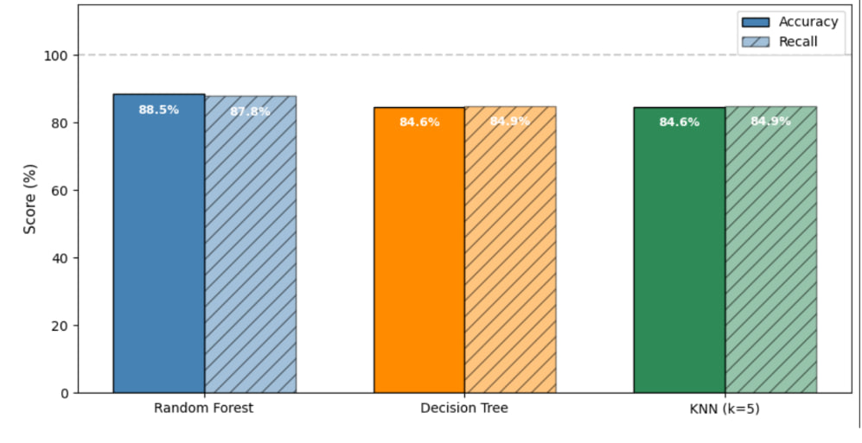
Model Comparison — Accuracy vs Recall

Slide 11




Key Takeaways
PCA successfully compressed 54,675 genes into 50 components while retaining 87.1% of the original variance.
Random Forest achieved 88.46% accuracy on unseen patients — strong performance for a 5-class medical classification task.
Glioblastoma and Normal tissue were classified with perfect precision and recall — the most clinically reliable predictions.
Smaller classes (Medulloblastoma, Pilocytic Astrocytoma) had lower recall, showing the impact of limited training data per class.
This shows real potential: gene expression profiling could one day support faster, less invasive tumor classification.

Slide 12


What's Next
Flask API
Web Interface
Validation
Serve the trained model as a web API for real-time predictions
Build a simple form where users input gene data and get a prediction
Test on external datasets to confirm generalization beyond GSE50161
Thank You
Questions & Discussion

